Slide 1
Notes:
The COVID-19 pandemic has dramatically changed how schools operate and has brought to the forefront the importance of prioritizing the health and well-being of all students. As schools prepare to create a new model for learning in the fall, finding new ways to support students’ physical, mental, and social-emotional health is paramount. Schools must offer physical education and health education as part of a well-rounded education for all students during COVID-19, regardless of whether they will be providing in-school learning, distance learning, or using a hybrid learning approach.
This PowerPoint provides schools with recommendations and considerations for school reentry for K-12 physical education, health education, and physical activity.
These school reentry considerations are intended to guide administrators, staff, and teachers as they prepare an environment for safe and supportive instruction in physical education, health education, and physical activity. Returning to school during the COVID-19 pandemic will require modifications and may feel overwhelming and challenging to school staff, teachers, and students. Recommendations included in this document are to be used as considerations by school staff to make decisions appropriate for their school or district’s circumstances.

Slide 2
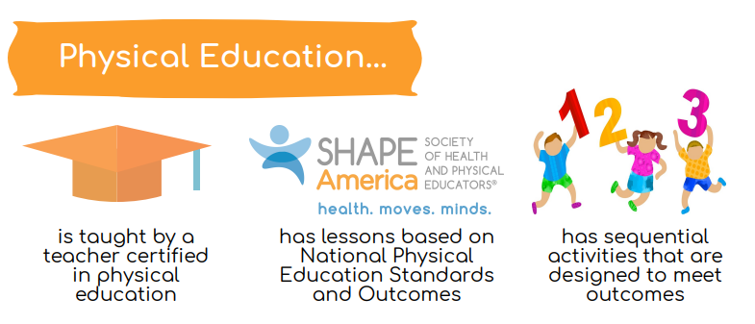
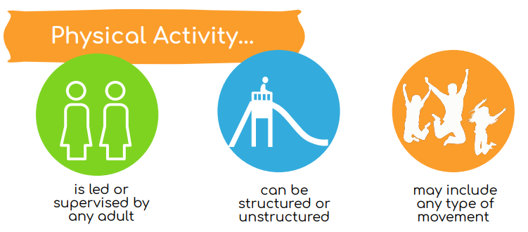
What’s the difference?
Notes:
During a global health crisis, developing physically literate and health literate students is more important than ever. Health literacy is defined by SHAPE America as, “the ability to access, understand, appraise, apply and advocate for health information and services in order to maintain or enhance one’s own health and the health of others” (SHAPE America, 2015). Physical literacy can be defined as, “the ability to move with competence and confidence in a wide variety of physical activities in multiple environments that benefit the healthy development of the whole person” (SHAPE America, 2014). Certified health education and physical education teachers are best equipped to deliver this necessary skills-based and standards-based instruction.
As schools work to adjust their models of student learning during COVID-19, it’s important to differentiate between physical education and physical activity, and for school leaders to understand their role in providing students with opportunities for both. Physical activity is bodily movement of any type and may include recreational, fitness and sport activities such as jumping rope, playing soccer, lifting weights, as well as daily activities such as walking to the store or taking the stairs. Schools should offer recess and classroom-based physical activity as opportunities for students to engage in physical activity throughout the school day. Additionally, physical education programs offer the best opportunity to provide physical activity to all children and to teach them the skills and knowledge needed to establish and sustain an active lifestyle. An effective physical education program, along with a skills-based health education program, provides learning opportunities, appropriate instruction, and meaningful and challenging content for all students.

Slide 3
Models of Learning
In-school instruction with physical distancing
Physical education
Health education
Recess
Classroom-based physical activity
Distance learning
Physical education
Health education
Hybrid learning (defined as a combination of in-school instruction with physical distancing and distance learning)
Physical education
Health education
Notes:
As schools prepare plans for reentry, they must first comply with all state, city or county, and school district guidelines for COVID-19. Schools should also follow guidance provided by the CDC and create a school-wide COVID-19 response team to prepare and implement reentry plans. This response team will be responsible for putting in place the necessary protocols to ensure school staff and students can attend school safely — which includes providing guidance on how to stop the spread of COVID-19, properly wash hands, promote everyday protective measures, and properly wear a face covering.
In the upcoming school year, schools will be operating under different models of learning based on their geographical location, level of COVID-19 community spread, feedback from families and the school community, and state or local regulations. In the considerations document, we provide some overarching strategies for schools to consider for reentry as well as considerations for the models of learning.
In-school instruction with physical distancing
Physical education
Health education
Recess
Classroom-based physical activity
Distance learning
Physical education
Health education
Hybrid learning (defined as a combination of in-school instruction with physical distancing and distance learning)
Physical education
Health education

Slide 4
Teaching Strategies for School Reentry
Notes:
While it’s critical for schools to develop school reentry plans that ensure the health and safety of students and staff, it is also important for educators and administrators to take into consideration the effects caused by social and physical distancing and the previous closure of schools. Students and staff have been affected mentally, physically, socially, and emotionally due to the abrupt interruption of their daily lives. They have had to adjust to a new normal, and many are managing complex emotions such as anxiety, fear, loneliness, and grief.
These feelings should be acknowledged, and teachers and school leaders should recognize how these feelings might affect student learning when developing units, assessments, and learning experiences for the return to school. Instruction in health and physical education can help students manage these emotions through the development of health skills, participation in physical activity, and overall development of health and physical literacy.
The considerations document provides teaching strategies for health and physical education related to equity, inclusion and accessibility; social and emotional learning (SEL); and a trauma-sensitive learning environment. Also included are recommendations for conducting an at-home student survey and strategies for student assessment. These overarching strategies should be considered no matter what model of learning the school is operating under.

Slide 5
Equity, Inclusion, and Accessibility
Student demographics, other school-age children at home, etc.
Access to internet and device access at home
Access to materials/equipment at home
Students with IEPs or 504 plans
English-language learners
Notes:
Equity, inclusion and accessibility must first be considered when planning curricular units, assessments, and learning activities for students. The pandemic has increased the equity gap in education and has highlighted disparities in student and teacher access to digital devices, learning materials, and the internet. According to a report released by the Pew Research Center, when schools were closed 15 percent of U.S. households and 35 percent of low-income households with school-age children did not have a high-speed internet connection at home (Pew Research Center, 2020).
Existing feelings of stress, anxiety, fear, and anger can be exaggerated when students lack necessary access to the internet, physical activity equipment, or devices to complete assignments. Additionally, the individual needs of students with disabilities, and culturally and linguistically diverse learners must be considered. Considering the logistical and emotional needs of students is extremely important, especially for those who may already have disadvantages prior to the COVID-19 pandemic. Schools should make sure that students can receive and access the course content necessary to learn.
Health and physical education teachers should address the below considerations when planning for school reentry, whether schools are operating under a model of in-school instruction, distance learning, or hybrid learning. These questions will provide important insights, which will help set realistic expectations and accurately prepare lesson materials so students can be successful.

Slide 6
Social and Emotional Learning
Identify natural alignment in existing curriculum (Crosswalk resources), as well as curriculum gaps
Intentionally highlight the SEL competencies being taught
Face coverings and their potential impact on the ability to interpret emotions and facial expressions
Analyze the new school environment and its impact on students
School-wide SEL plan
Notes:
Social and emotional learning (SEL) is a critical component of educating today’s youth and a key component of health and physical education instruction. In preparing for school reentry, intentionally incorporating SEL will be essential to supporting students through the COVID-19 pandemic. Right now, “children of all ages are struggling with the ensuing stress and trauma. While adversity impacts learning, these effects can be mitigated by strong, trusting relationships and opportunities to develop social and emotional learning (SEL) skills” (Darling-Hammond, 2020). Many administrators and educators have struggled to effectively incorporate SEL throughout the culture of their school, even prior to COVID-19. Physical education and health education naturally support and align with CASEL’s SEL core competencies. These skills can be developed through distance learning, hybrid, or in-school instruction.
-SEL School-wide plan and Work with other staff members (e.g., school counselor, school nurse, social worker, school psychologist, other teachers, librarian) to share SEL-specific skills being taught
-Use daily routines to incorporate SEL skills (e.g., morning circle, instant activities/warm-up, introductions, and closures)
Face coverings and their potential impact on the ability to interpret emotions and facial expressions
Use daily routines to incorporate SEL skills Prepare for emotional, social and skill regression
Analyze the new school environment and its impact on students

Slide 7
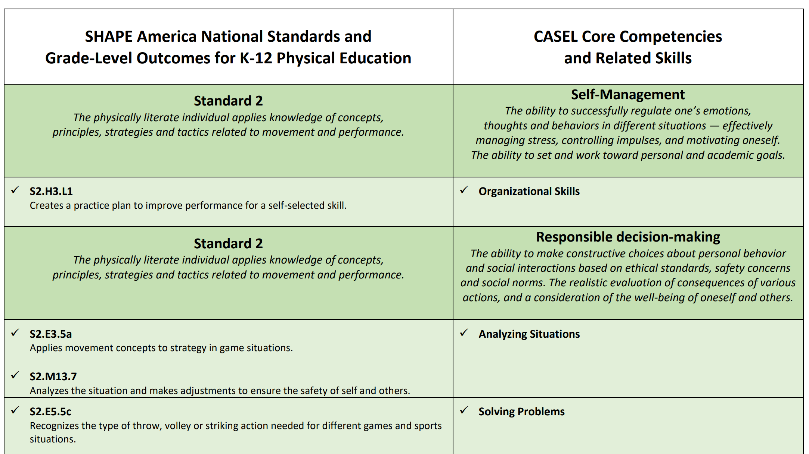
SEL Crosswalks for HPE
Notes:
Health and physical educators are on the front lines of the SEL movement — and can maximize their role by creating an optimal classroom environment and teaching students the social and emotional skills and behaviors that will help them succeed in all areas of their lives. Because there is congruency between SEL competencies and the National Standards for K-12 Physical Education and Health Education, SEL should be integrated into the health and physical education classroom throughout all grade levels.
This document aligns CASEL’s SEL competencies and related skills to SHAPE America’s National Standards and Grade-Level Outcomes for K12 Physical Education. This document serves as a resource for those aligning SEL competencies into the existing National Standards and Grade-Level Outcomes for K-12 Physical Education and can be a foundational document to help states and/or districts develop specific guidance that incorporates their own policies, standards or guidance for SEL. This table is not intended to be exhaustive and additional alignments may be made with other National Standards and Grade-level Outcomes for K-12 Physical Education. The crosswalk identifies standards that are applicable to teaching and/or reinforcing one or more of SEL competencies. A crosswalk of the CASEL SEL competencies and the National Health Education Standards will be released later this summer.

Slide 8
Trauma-sensitive Learning Environment
- Provide opportunities for connection (both with peers and the teacher)
Create a predictable setting and routine
Keep or create opportunities for student choice and voice
Evaluate current student behavior management
Assess your students’ emotional needs
Assess your emotional needs throughout the day
Notes:
Mental health experts anticipate that many students will have experienced trauma related to the COVID-19 pandemic. Students will not be prepared to engage in learning if they do not feel physically and emotionally safe. A trauma-sensitive mindset can be applied to all facets of education: teaching strategies, behavior management, assessment, and policies. Creating a trauma-sensitive learning environment in health and physical education — and throughout the school — will be imperative to help students ease the impacts of trauma on their life.
“Trauma is an exceptional experience in which powerful and dangerous events overwhelm a person’s capacity to cope” (Rice and Groves, 2005). It’s important to note that an event doesn’t have to be life-threatening to be traumatic; it’s the child’s response and interpretation of the event that matters. Trauma impacts the brain and can have lasting effects on child development and a student’s ability to learn.
Strong relationships and connections with students are at the heart of creating trauma-sensitive learning environments. In preparing for reentry into schools, educators should allocate more time to fostering relationships and building community within their classes than they might have done prior to the COVID-19 pandemic.

Slide 9
At-home Student Survey
Student demographics, other school-age children at home
Access to internet and device access at home
Access to materials/equipment at home
Goals (content and skills) and concerns for the next school year
Gather information in order to build connect with your students
Ask families to share anything else they feel would be helpful for you to know
Notes:
Health and physical educators need to consider how to create activities, lessons and units that keep equity, inclusion and accessibility, SEL, and a trauma-sensitive learning environment at the forefront. Many of the considerations are interrelated and adapting or creating new routines or classroom management procedures that incorporate the above concepts are great beginning steps to help your students prepare for learning. One strategy that can be used to gather the important information you need to know about how your students will learn best, especially during this time of COVID-19, is conducting an at-home student survey. The survey will help you design appropriate learning experiences and serve as the first step in building a meaningful relationship with students. The considerations document includes sample information to collect in an at-home student survey.

Slide 10
Student Assessment
Understand that assessment happens in many ways — and can be assessment for learning or assessment of learning
Use backward planning to develop a variety of standards-based assessments
Offer opportunities for students to choose how they will demonstrate their knowledge and skills
Use formative assessments to determine what concepts students understand and what students may be struggling with
Use simple rubrics so your students understand how they will be assessed and what they will be assessed on
Notes:
Regardless of the delivery method, the goal of physical education and health education remains the same: to develop a student’s physical and health literacy. It is important that some level of assessment be incorporated as part of any well-designed health and physical education program. Additionally, state- or district-level requirements for assessment must be considered and adapted as necessary to fit the school’s current model for learning.
Specific considerations related to assessment:

Slide 11
In-School Instruction With Physical Distancing
Notes:
If the school district deems it safe and appropriate to reopen school buildings based on CDC guidance and state and local regulations, many new protocols and precautions must be put in place to ensure the health and safety of school staff and students. For in-school instruction, create protocols that allow staff and students to maintain physical distancing guidelines and remain 6 feet apart throughout the entire school day. All teachers should be aware of the school-wide COVID-19 response team’s plan for sanitation, how to implement a plan for accommodating sick students, and how to monitor any patterns of illness or other concerns that may arise. Schools should also consider accommodations that allow staff and students with underlying medical conditions (that put them at higher risk for severe illness) the opportunity to work or learn from home.
Schools should consider ways to maintain student and staff groupings that are as static as possible by having the same group of students stay together in a learning cohort — all day for young students and as much as possible for older students. Limit non-essential visitors on school grounds and in classrooms. Consider if and/or when it may be appropriate to cancel or reschedule field trips, inter-group events, and extracurricular activities, based on local community COVID-19 guidelines. This next section will provide some specific considerations for in-school instruction with physical distancing for physical education, health education, and recess.

Slide 12
Physical Education
PHYSICAL ENVIRONMENT
Location and facilities considerations
Class size and structure considerations
Provide visual reminders of physical distancing practices
Coordinate with classroom teachers and COVID-19 response team
Consult with COVID-19 response team on proper sanitation procedures
Drinking fountains should be sanitized frequently or be out of service
PERSONAL HYGIENE
Teachers and students should wash or sanitize hands frequently
Face coverings worn, if possible
Notes:
Physical education provides K-12 students with a planned, sequential, standards-based program of curricula and instruction designed to develop motor skills, knowledge and behaviors for active living, physical fitness, teamwork, self-efficacy, and emotional intelligence. The skills and knowledge gained by students through physical education are especially important during the COVID-19 pandemic. SHAPE America and CDC recommend that all students participate in daily physical education in grades K-12, with instruction periods totaling 150 minutes per week in elementary school and 225 minutes per week in middle school and high school. Here are some considerations for the physical environment, personal hygiene, equipment safety & sanitation, and instructional strategies for physical education.
Pages 13-14 of considerations document

Slide 13
Physical Education
EQUIPMENT SAFETY & SANITATION
Consult with COVID-19 response team on proper sanitation procedures
Limit use of equipment and eliminate use of shared equipment
Safely apply and store cleaning and disinfectant supplies
Keep student’s belongings separate
INSTRUCTIONAL STRATEGIES
Continue to address all five National Standards for K-12 Physical Education
Use microphone or speaker to accommodate increased physical distancing
Focus more on individual pursuits or skills that do not require physical contact
Notes:
The School Reentry Considerations: K-12 Physical Education In-School Instruction With Physical Distancing Supplement document, which we will cover in a moment, includes examples of National Standards and Grade-Level Outcomes that physical educators should focus on during in-school instruction, with accompanying example activity ideas and strategies for implementation. This list is not meant to be exhaustive, but to provide some specific examples that hopefully serve as a catalyst for educators to generate additional ideas.
Pages 15-16 of considerations document

Slide 14
Health Education
PHYSICAL ENVIRONMENT
Follow CDC guidelines for physical distancing, healthy hygiene habits, and sanitation for classrooms
Space desks at least 6 feet apart and have students face same direction
Keep student’s belongings separate
Eliminate sharing of high-touch materials and disinfect supplies after student use
INSTRUCTIONAL STRATEGIES
Utilize a skills-based approach to health education that include:
Analyzing influence
Accessing valid and reliable information, products, and services
Interpersonal communication
Decision-making
Goal setting
Self-management
Advocacy for self and others
Notes:
Health education provides students with the knowledge and skills necessary to practice healthy behaviors and teaches students how to recognize the influence of responsible decision-making on quality of life. By providing effective health education programming, schools can help students develop health literacy skills, so they are able to access information, resources, and services in order to maintain a healthy lifestyle. The development of these skills by students is especially important during the COVID-19 pandemic.
Pages 17-18 of considerations document

Slide 15
Recess
Provide recess or free time whenever possible
Do not withhold recess as punishment
Identify multiple indoor and outdoor spaces for recess to minimize crowding
If indoors, keep doors and windows open and ensure proper ventilation
Create play areas and encourage recess activities that do not require physical contact or use of recess play equipment or playground structures
Notes:
Recess should not be eliminated if schools are operating under a model of in-school instruction with physical distancing. Recess helps students achieve the recommended 60 minutes of physical activity per day for children and adolescents, which can improve strength and endurance, enhance academic achievement, and increase self-esteem. Recess also helps students practice social skills such as cooperation, following rules, problem-solving, negotiation, sharing, and communication. Opportunities for free play, to engage in physical activity, and to practice social skills are especially important during the COVID-19 pandemic.
Pages 18-19 of considerations document

Slide 16
Classroom-based Physical Activity
Consult with COVID-19 response team on proper sanitation procedures
Keep doors and windows open and ensure proper ventilation
Identify ways to create and use classroom space for physical activity that allows for physical distancing
Ensure classroom physical activity is appropriate and safe for all students by setting and communicating safety and behavioral expectations
Notes:
While maintaining physical distancing measures is critical in mitigating the spread of COVID-19, classroom teachers can still provide opportunities for students to be active throughout the school day (in addition to physical education and recess). Incorporating activity breaks during classroom learning can increase the amount of time students are physically active throughout the day and limit the amount of time they are sedentary. SHAPE America partner Springboard to Active Schools provides schools with key resources to easily implement strategies for classroom physical activity. Classroom-based physical activity improves students’ concentration and attention, behavior, motivation and engagement in the learning process, and academic performance.
Providing opportunities for classroom-based physical activity can be used as a strategy to mitigate feelings of stress and anxiety brought on by the COVID-19 pandemic. CDC guidelines regarding physical distancing should be followed when engaging in classroom-based physical activity. If deemed safe by school administrators, open the doors and windows to the classroom to maximize circulation and air flow to accommodate for increased respiration by students while participating in physical activity. Consult with the school-wide COVID-19 response team to ensure the room’s ventilation system is working properly.
Pages 19 of considerations document
Springboard to Active Schools Strategies for Classroom Physical Activity in Schools: https://schoolspringboard.org/classroomphysicalactivity/#:~:text=Classroom%20physical%20activity%20gives%20students,of%20time%20they%20are%20sedentary.

Slide 17
Distance and Hybrid Learning for Physical Education and Health Education
Notes:
Depending on the local circumstances surrounding COVID-19, schools may need to provide distance or remote learning for students. Even when students are learning at home, health and physical educators should provide students with guidance and activities to help them meet the national recommendation of 60 minutes or more of moderate-to-vigorous physical activity daily for children and adolescents ages 6-17. School districts and schools must create equitable distance learning opportunities for all students, including those students without access to the internet, mobile devices, or other equipment. Health and physical educators should follow guidelines from their district or school regarding distance learning when creating curricular units, assessments, and learning activities.
This section includes general considerations and strategies for distance learning for physical education and health education. Teachers should also use the suggestions provided in the Teaching Strategies for School Reentry section (Equity, Inclusion and Accessibility; SEL; Trauma-Sensitive Learning Environment; Conducting an At-Home Student Survey; and Student Assessment) to determine what content and skills to focus on. Teachers should continue to provide an array of learning activities for students to complete at home that provide opportunities to work toward the National Health Education Standards and all National Standards for K-12 Physical Education.

Slide 18
Distance Learning Model
- Develop connections
- Assess your curriculum
- Communicate expectations
- Create consistency
- Make content accessible for all learners
Notes:
In the hybrid learning model, students attend school in person on a staggered schedule. For example, some students attend school in the mornings while others attend in the afternoons, or attendance is staggered by days of the week. When not attending school in person, students participate in distance learning.
When developing their curricular units, assessments, and learning activities, health and physical education teachers following the hybrid model should use the strategies and considerations listed above for in-school instruction with physical distance learning. Any considerations listed above for the in-person with physical distancing and distance learning models of student learning should also be applied in the hybrid learning model.
View the School Reentry Considerations: K-12 Physical Education Distance Learning Supplement for examples of National Standards & Grade-Level Outcomes that physical educators should prioritize with distance learning. This list is not meant to be exhaustive, but to provide some specific examples that hopefully serve as a catalyst for educators to generate additional ideas. Some of the activities included in the School Reentry Considerations: K-12 Physical Education In-School Instruction With Physical Distancing Supplement may also be appropriate to use in a distance learning environment. For additional activity ideas and best practices view the Guidelines for K-12 Online Physical Education.

Slide 19
Hybrid Learning Model
Consider having students practice a skills at home and then apply during a class activity
Students can participate in individual physical activities with physical distancing guidelines that require little or no equipment and at-home can focus on motor skill development
Consider flipped classroom approach or project-based learning
Allow for optimal student choice and opportunities to engage directly with teachers
Notes:
In the hybrid learning model, students attend school in person on a staggered schedule. For example, some students attend school in the mornings while others attend in the afternoons, or attendance is staggered by days of the week. When not attending school in person, students participate in distance learning. When developing their curricular units, assessments, and learning activities, health and physical education teachers following the hybrid model should use the strategies and considerations listed above for in-school instruction with physical distance learning. Any considerations listed above for the in-person with physical distancing and distance learning models of student learning should also be applied in the hybrid learning model.

Slide 20
K-12 Physical Education In-School Instruction With Physical Distancing
Notes:
Educators can use strategies, guidance, and activity examples from both the in-school instruction with physical distancing section and the distance learning section for hybrid instruction.
This table provides examples of SHAPE America’s National Standards & Grade-Level Outcomes for K-12 Physical Education along with accompanying example activity ideas and strategies for implementation. Educators should continue to address all five National Standards for K-12 Physical Education by selecting associated activities that require little or no use of shared equipment by students. Educators may need to shift the focus of their curriculum to Standard 3 (health-enhancing fitness), Standard 4 (personal and social responsibility) and Standard 5 (value of physical activity) and incorporate activities for Standard 1 (motor skills and movement patterns) and Standard 2 (movement concepts) that are safe and appropriate.

Slide 21
K-12 Physical Education Distance Learning Supplement
Notes:
During distance learning, educators should continue to address all five National Standards for K-12 Physical Education by selecting associated activities that require little or no use of shared equipment by students. Educators may need to shift the focus of their curriculum to Standard 3 (health-enhancing fitness), Standard 4 (personal and social responsibility) and Standard 5 (value of physical activity) and incorporate activities for Standard 1 (motor skills and movement patterns) and Standard 2 (movement concepts) that are safe and appropriate. NOTE: In some situations it may not be possible to address all Grade-Level Outcomes due to the constraints of distance learning.
Below are recommendations for what National Standards & Grade-Level Outcomes should be prioritized specifically while students are at home. This list is not meant to be exhaustive, but to provide some specific examples that hopefully serve as a catalyst for educators to generate additional ideas. Be sure to collect a student inventory of available household items. Additionally, some educators maybe able to find safe ways to incorporate some of the activities provided in the In-School Instruction With Physical Distancing supplement.

Slide 22
Supporting Resources
Guidelines for K-12 Online Physical Education
Effective Teaching Practices Using SHAPE America School Reentry Considerations
K-12 Physical Educators
K-12 Health Educators
School Reentry Resources
At-Home Student Survey template
Teaching Strategies Workbook
Prioritizing HPE one-pager
Kaiser Permanente’s Planning for the Next Normal Playbook
Notes:
The School Reentry Considerations: K-12 Physical Education In-School Instruction With Physical Distancing Supplement, the School Reentry Considerations: K-12 Physical Education Distance Learning Supplement, and the instructional strategies outlined earlier in this document for health education provide examples of specific learning activities that can be utilized by health and physical educators. These are some additional resources that support the implementation of the School Reentry Considerations. Although returning to school will present many challenges for communities, educators, families and students, health and physical education provides a vital opportunity for students to gain the knowledge and skills to be physically, mentally, and emotionally healthy.

